Slide 1
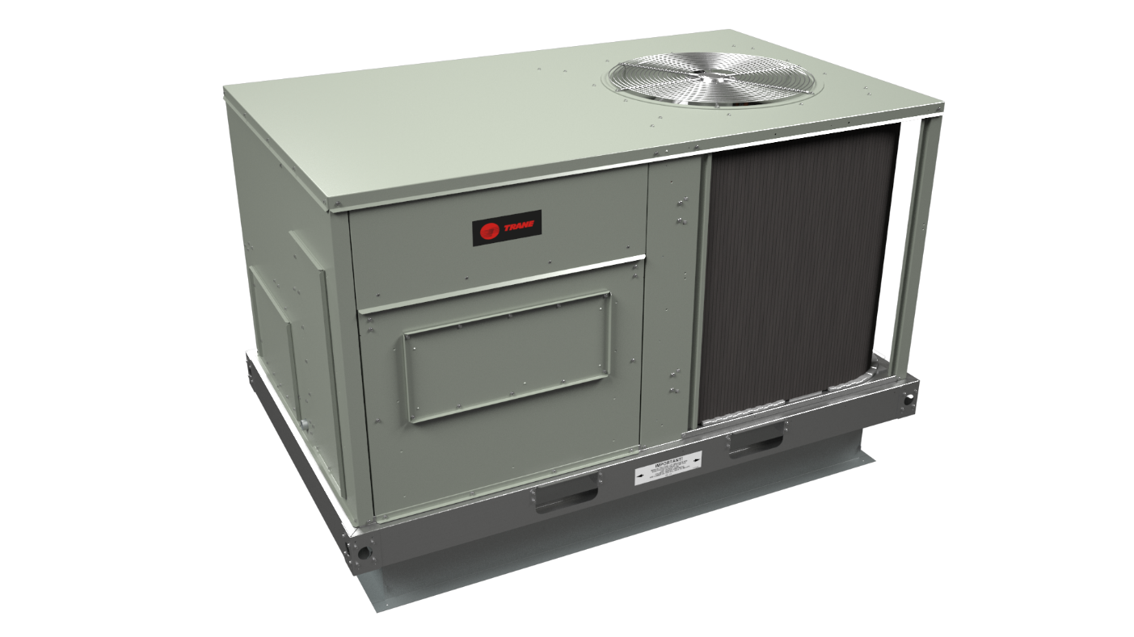
Trane FoundationTM
3 – 5 Ton Light Commercial Rooftop Unit
Notes:
Thank you for joining our call today. I am (presenter should insert their name here) and I am the (insert job title or if better a short description of job – some titles are confusing to people). If there is more than one presenter they should introduce themselves as well at this point.
I would like to cover a few housekeeping items at the beginning of this call especially for those of you unfamiliar with Adobe Connect functionality.
You will notice a chat box at the bottom of the presentation. Please feel free to enter any questions you have during the presentation in that box. Enter the question as soon as you think of it. We will address the questions during the presentation and at the end we will also look through the chat to make sure we did not skip any of your connections.
So before we get started I am going to ask you a question.

Slide 2
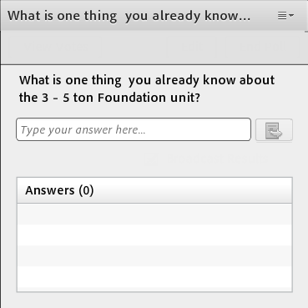
What is one thing you already know about the 3 – 5 ton Foundation™ unit?
Notes:
Do you see the poll question on your screen?
Please type your answer in the poll.
Give them a couple of minutes and then....
Those are great answers!
If anyone said something that is not true go ahead and address it now.
You have demonstrated that you know some information about the unit let’s see if we can expand on that knowledge now.

Slide 3
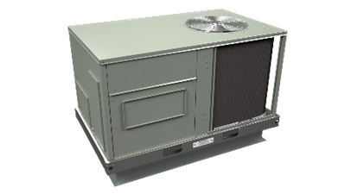

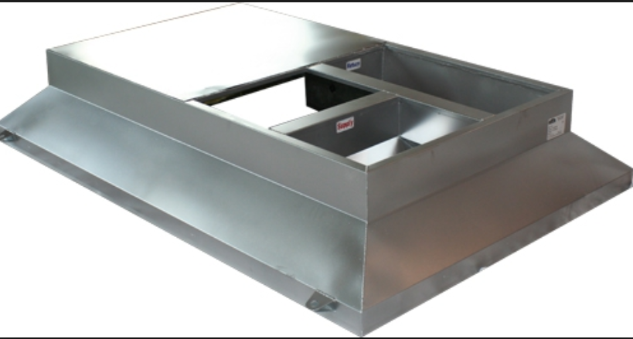
3-5 Ton Foundation™ Rooftop Unit
Fits on existing Carrier® Curbs
Price Competitive
Straightforward to install
    No Curb Adaptor Needed
Notes:
What is the most important thing you need to remember at the end of this call?
Here it is:
The 3 – 5 ton Foundation rooftop unit fits on existing Carrier curbs, it is price competitive and it is straightforward to install!
That’s pretty simple isn’t it?
Maybe you would like a few more details??

Slide 4
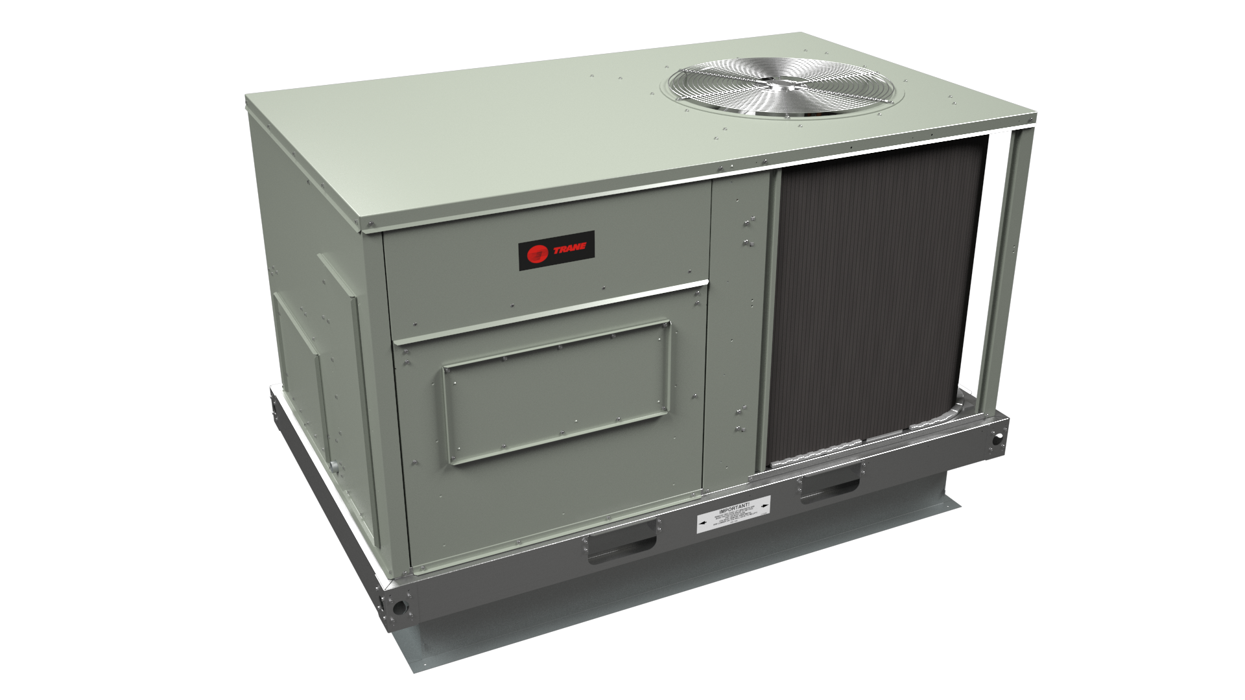
Agenda
Competitive Summary
Product Positioning
General Information
Resources
Notes:
Today we are going to look at where the foundation unit fits in the market, provide you with more features of the product, give you some competitive information and let you know what resources are available to you to help you sell.

Slide 5





How do we serve the package rooftop market today?
Tonnage
Ranges
Efficiency Ranges
Options Available
Comments
3-5
Several levels of product efficiencies. Limited options available (mostly field installed)
Impack®
3-5,
15-25
Minimum efficiency levels. Reduced number of factory and field installed options.
FoundationTM
Multiple levels of efficiency. Numerous factory and field installed options
Precedent®
3-10
Multiple levels of efficiency. Numerous factory and field installed options
Voyager®
12.5-25
Notes:
Let’s look at Trane’s offerings in the light commercial rooftop market. Trane offers four different models of 3-phase packaged equipment in 3 to 25 tons. As you can see there is some overlap in these offerings, but when you factor in the efficiency ranges and options you can see that each model serves a different segment of the market place.
Let’s start with the Impack unit, it is offered in 3-5 tons for three phase applications. The efficiency ranges from 14 to 16 SEER and they have a relatively limited number of mostly field installed options.
The Foundation unit is offered in 3-5 tons as well as 15-25 tons. It has a basic set of options and meets the minimum efficiency levels. We will talk much more about this unit later in the call, but this gives you an idea where the unit fits in the lineup as a whole.
Next up is the Precedent unit. It is offered in 3-10 tons and has several efficiency options ranging from standard 14 SEER efficiency to Ultra High Efficiency eFlex units. The Precedent has a number of factory installed options as well as field installed accessories.
Moving up the tonnage range, the next in line is the Voyager 2 unit. It is available from 12.5 to 25 tons with many factory and field installed options and available with variable speed compressors that enable efficiency levels of up to 21 IEER.

Slide 6





Market Dynamics – 3-25 Tons
WeatherMaker®
Precedent® & Voyager®
Rebel
Landmark ® & Raider ®
FoundationTM
Energence
Precedent & Voyager (eFlexTM)
Product Features and Options
Centurion
Precedent® & Voyager®
Precedent® & Voyager®
Prestige TM
Precedent®
& Voyager®
Landmark®k
WeatherExpert ®
WeatherMaker®
WeatherMaster ®
Precedent® & Voyager ® (eFlexTM)
Landmark® & Raider®
*
FoundationTM
Precedent® & Voyager ®
Competitive Segment
Efficiency
Notes:
Where does Foundation fit in the market?
If you look at the landscape for light commercial products the foundation line of equipment fits in the lower left corner of the chart.
Standard efficiency with fewer product features and options. What we call entry level units.
These units meet the minimum efficiency requirements and are typically outfitted with only the basic features and options that would be required for a job. As you can see there are several competitors in this market.

Slide 7
Agenda
Competitive Summary
Product Positioning
General Information
Resources
Notes:
Now that we have framed the Foundation unit by discussing the marketplace and our own Light Commercial rooftop lines, lets look at some of the details of the new Foundation unit.

Slide 8

Trane FoundationTM Light Commercial Rooftop Unit
3-5 Ton Units
  TOPSS® replication 196
  Cooling Only w/Optional Electric Heat
  Gas Heat
14 SEER/12 EER
Voltages:208/230 VAC, 460 VAC, 575 VAC
Convertible Airflow
Fits common roof curb used on existing buildings allowing you the option to use Trane in more replacement opportunities
Notes:
3 – 5 ton units are offered in cooling only, electric heat and gas heat… no heat pump at this time.
These units meet the basic efficiency requirement of 14 SEER and are offered in 208/230, 460, and 575 Volts as well as 380 volt 60Hz.
All of the 3-5 ton units are standard with Convertible airflow configuration and feature a single footprint that matches the commonly found Carrier footprint.

Slide 9
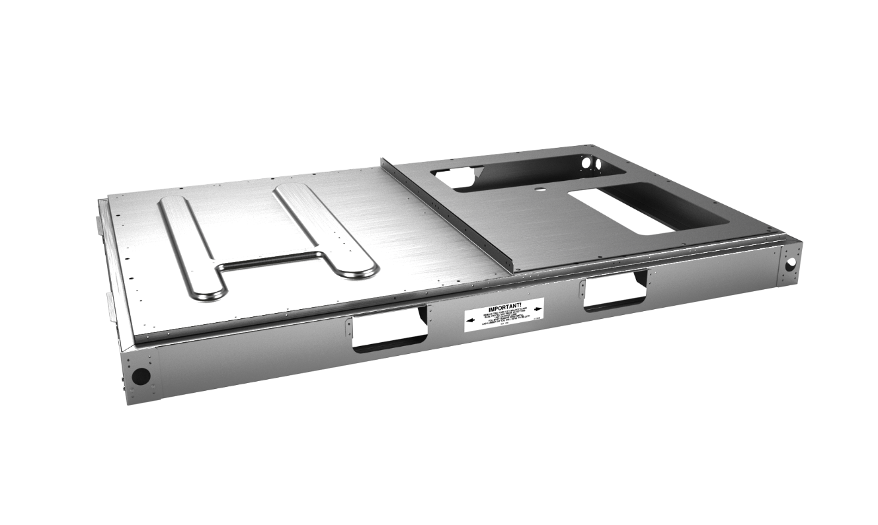
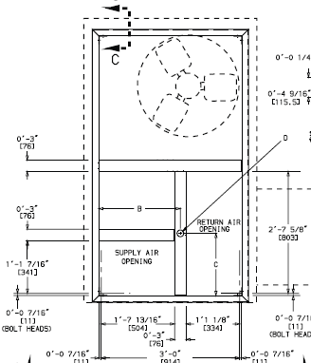
Product Highlights – Footprint
Single footprint for 3-5 tons
Most commonly found replacement footprint
  Select “Blue Oval” units dating to 1980’s
Reduce Job Cost
  No Adapter Curb!!!
  Minimal Setup
Weighs less than comparable Carrier® unit
Notes:
One of the BIG DIFFERENCES between the new 3-5 ton Foundation product and the current 15-25 ton models is the footprint. The 15-25 ton units have what we refer to as a “dual footprint”, meaning they are designed to sit either on a Trane curb or an existing Carrier curb.
The new 3-5 ton unit does not share this same “dual footprint” design, but instead matches the Carrier style curb only. This a very common curb with a LARGE installed base.
So the new Foundation unit will allow you to fit those applications just like the competition without the additional cost of a curb adapter.
In addition to the cost savings of the curb adapter itself, there is also the additional labor and crane savings by sitting directly on the existing curb, not to mention avoiding some of the problems that you commonly encounter with curb adapters such as incorrect fit, excessive unit height, and additional pressure drop.
Eliminating the need for a curb adapter places you on a level playing field with the competition.

Slide 10
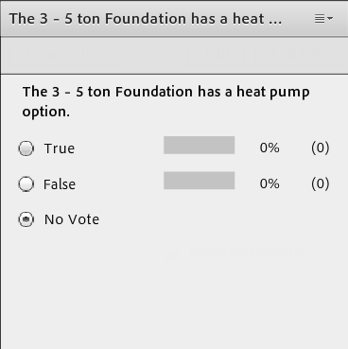
Fact Check
The 3 – 5 ton Foundation™ has a heat pump option.
True
False
Notes:
Do you see the poll question?
Please take a minute and answer it.
(If anyone answers true go back to slide 8 to review the information.)

Slide 11
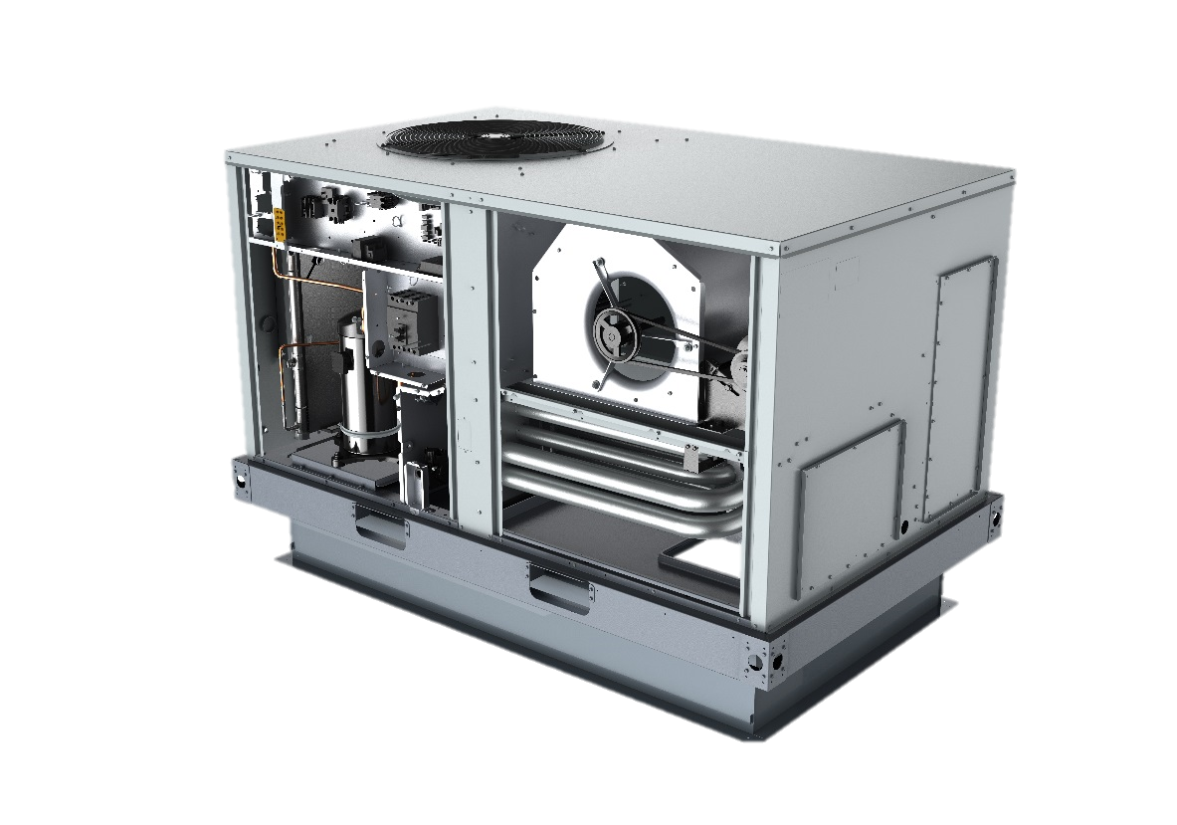
Product Highlights –
Unit Cabinetry
A
Electromechanical Controls
A
E
B
Single side service access
D
C
Convertible design (no kit required)
B
C
D
Optional non-fused disconnect
E
One piece top cover
F
F
3 sided fork access
G
Non-corrosive drain pan (not shown)
Notes:
This unit is laid out keeping service in mind.
(A) The Foundation unit comes standard with Electromechanical controls, with the goal of making installation and start-up simple and quick, no special tools or training required… just simple thermostat connections that every contractor is familiar with.
(B) Keeping with the theme of easy service, the Foundation has Single side service access. Everything you need to access for service purposes such as the controls, compressors and fan belts are all located on the side shown here. Filter and economizer access will be on the opposite side.
(C) This unit has supply and return air openings that are field convertible from horizontal to vertical configuration. Simply remove the duct covers from the horizontal opening and place over the vertical openings or vice versa, the same for the standard economizer… it is convertible from downflow to horizontal with no special kits required.
(D) We offer an optional unit mounted disconnect.
(E) All 3-5 ton units have a Single Piece top cover to provide superior protection from the elements.
(F) They have fork access from 3 sides for ease of moving at the warehouse and at the jobsite.
(G) All Foundation units come with a Non-corrosive drain pan as standard

Slide 12
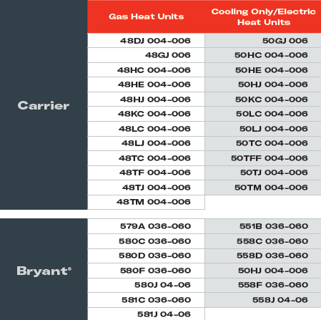
Product Highlights – Footprint
Foundation™ 3-5 Tons
Replaces common Carrier® units dating back to the mid-1980’s as well as other manufacturers’ units
3 – 5 Ton Replacement Matrix
3-5 Ton Foundation™ units do not match the Trane Precedent® Footprint
See HUB solution for full quick reference matrix and other sales tools
  Search for ‘Foundation™ Curb Matrix’
Notes:
We have several sales tools that we will discuss later, but one I would like to point out to you now is the 3-5 ton Curb Matrix.
Similar to the 15-25 ton curb matrix, this curb matrix lists all of the Carrier and Bryant part numbers that can be replaced with the Foundation unit without the need for a curb adapter. Also, you will find a more exhaustive list on the HUB that lists units that will NOT match the Foundation footprint as well as the model numbers for some other manufacturers who have a similar design to the Carrier footprint.
If you go to the HUB and search for “Foundation Curb Matrix” you will see both of these useful sales tools. There you will see not only this curb matrix but also other valuable tools such as competitive comparisons, PowerPoint presentations and other literature.

Slide 13
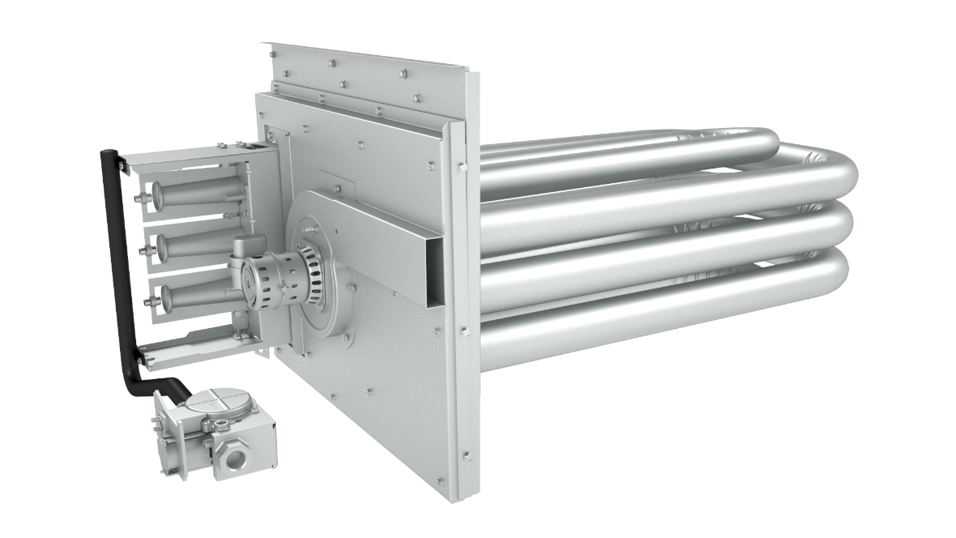
Product Highlights – Heat Exchanger
Compact, Tubular Design
  Based on Impack Heat Exchanger
  Proven Reliability
Direct Spark Ignition
(same board used on current Impack® unit)
2 Heat Sizes
  Low & Medium
  1 Stage (low), 2 Stage (med)
Stainless Steel Option
Tons | Low Capacity (Input/Output) | Medium Capacity (Input/Output)
3 | 72,000 / 57,600 | 100,000 / 80,000
4 | 72,000 / 57,600 | 115,000 / 92,000
5 | 72,000 / 57,600 | 115,000 / 92,000
Notes:
Now let’s take a look at the Heat Exchanger for the 3-5 ton Foundation units.
Like the 15-25 ton units, these smaller units utilize a tubular heat exchanger design. This particular design is based on the one currently used on the Impack product line, so it has proven reliability. It differs from the 15-25 ton units in that it utilizes secondary heat exchanger tubes for a more compact design.
In addition to sharing the heat exchanger design with the Impack units, the 3-5 ton Foundation unit also shares the same ignition board. Once again, this proven design improves the units reliability.
There are two heat capacities offered on each of these units. These two heat options are different from what you see on the Precedent unit.
The low capacity offering is a single stage heater and the medium capacity offering is standard with two stages.
Also, there is a stainless steel heat exchanger option and it will carry a 10 year parts only warranty as standard.

Slide 14
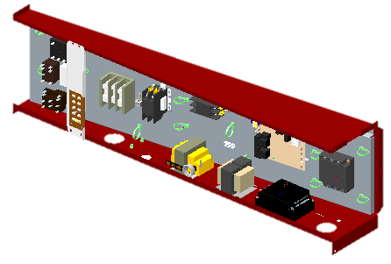
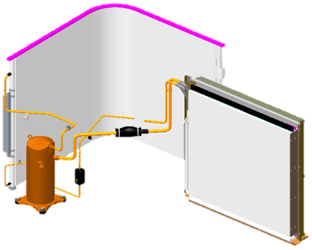
Product Highlights – Other Areas
Control Box
  Electromechanical controls
  Separation of high and low voltage components
  Emergency Stop Integration
  Low Voltage Terminal Strip
  Phase Monitor Standard
Refrigeration System
  Microchannel Cond & Evap Coil
  Single Stage
  TXV Metering Device
Indoor Fan Subsystem
  Belt-drive
  Oversized motor option
Notes:
So as we wrap up some of the 3-5 ton product highlights.
As we discussed before, the goal with this product was to provide a simple and straightforward unit. In keeping with that goal the Foundation units are available with standard electromechanical controls.
Also, the control box high and low voltage components have been separated into two separate compartments. This serviceability keeps the high voltage components from being intermingled with low voltage.
Like today’s Precedent and Voyager products, we have added an emergency stop interlock. This is an interface that provides the ability to shut the unit down when the emergency stop opens.
One other feature added that aids in quick start up is an accessible low voltage terminal strip for thermostat connections.
On the refrigeration side… As you know, we have been using Microchannel condenser coils for several years now on Precedent and Voyager units as well as the 15-25 ton Foundation units. You are probably aware of the benefits of this type coil, they have been well documented and include: a reduction in leaks, a reduced refrigerant charge which in turn leads to improved compressor reliability.
Now with this latest product release, we are using the Microchannel design for the evaporator coils as well. So the same benefits that you have seen with the Microchannel condenser coil will be seen now with the evaporator coil as well.
In addition we have Belt Drive supply fans on these units with an option to go to an oversized motor for higher static applications.

Slide 15
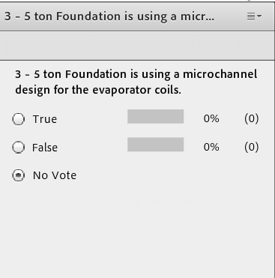
Fact Check
3 – 5 ton Foundation™ is using a microchannel design for the evaporator coils.
True
False
Notes:
Please take a moment to answer the poll question on the screen.
(If anyone answers False go back to previous slide and review information.)

Slide 16
Agenda
Product Positioning
General Information
Competitive Summary
Resources
Notes:
I would like to take a moment to look at some of the other manufacturers’ products with which the Foundation unit will be competing. As we mentioned earlier in the presentation there are several manufacturers with units in this entry level standard efficiency tier product and it is good to be aware of any differences that exist.

Slide 17
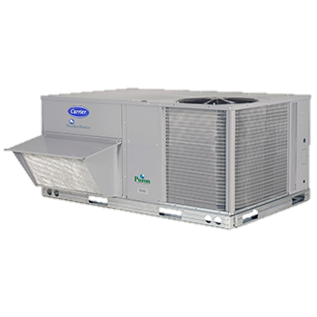
Competitive Summary
Carrier® - WeatherMaker® (48/50KC)
14 SEER*
Uses the same roof curb since 1989
Al/Cu Fin/Tube Coils (Cond. & Evap.)
Base Electromechanical
Multiple motor/drive options – up to 2” capability
Phase monitor available only as a field installed option.
Fixed Orifice expansion device
Capacities about the same as the Foundation™ units
Weighs about the same as Foundation™
* Carrier® WeatherMaker® 48TC unit has an efficiency of 13 SEER.
Although the unit cannot be manufactured after Jan 1 2017, existing inventory can still be sold.
Notes:
The first one we will discuss is the Carrier WeatherMaker. This Carrier unit is the main competitor that is targeted with the Foundation line.
Their base model is the 14 SEER 48/50 KC unit. I want to mention that you MAY run into some 13 SEER 48TC units as you are out quoting units. These are units that were made prior to January first of this year. Like everyone else, once the existing inventory of these 13 SEER units is gone, then the 48KC will be the base unit for this size range.
One of the main physical differences that you will see between the Carrier WeatherMaker unit and the Foundation is Carrier’s use of Copper Tube/Aluminum fin coils in lieu of Mircochannel, for both the evaporator AND the CONDENSER coils.
Carrier’s base unit has electromechanical controls and has several motor/drive options for different levels of static pressure.
One advantage we have is a standard phase monitor whereas this is a factory installed option not typically found in the stocked WeatherMaker unit.
Other than that, the capacities and weights of the WeatherMaker unit are about the same as the Foundation.
And as you are probably aware Bryant also has a version of this same unit.
Next Slide…

Slide 18
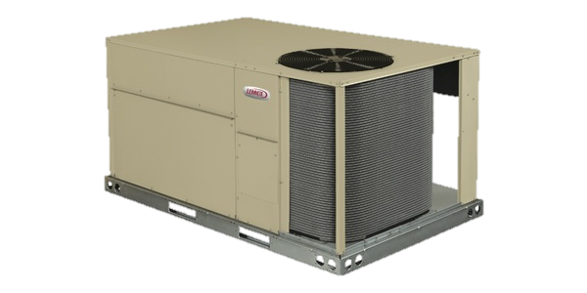
Competitive Summary
Lennox® – Raider® (ZG/ZC)
14 SEER
Designed to fit Carrier® WeatherMaker® curb
Standard Electromechanical Controls
Microchannel Cond Coil / Fin/Tube Evap. Coil
Fixed orifice expansion device
Similar feature set to Foundation™
Capacities about the same as Foundation™
Notes:
Lennox offers a unit, called Raider, similar to the Foundation, geared toward the Carrier replacement market.
Of the competitors in this market segment, the Lennox unit most closely matches the Trane Foundation unit from the standpoint of feature set and performance.
It is a 14 SEER unit with rated capacities close to those of the Foundation units.
It has standard electromechanical controls and a convertible design like the Foundation.
But a few of the advantages we have over the Lennox unit are:
A factory installed phase monitor, for additional reliability
TXV in lieu of Lennox’s fixed orifice expansion device to give better performance through the entire operation range.

Slide 19
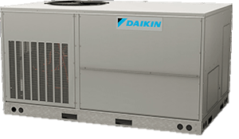
Competitive Summary
Daikin® DSC/DSG
14 SEER
Designed to fit Carrier® WeatherMaker® curb
  (not as close fit as others)
Standard Electromechanical Controls
Copper Tube / Aluminum Fin Coils (Cond & Evap.)
Similar feature set to Foundation™
Capacities slightly less than Foundation™
Notes:
The last competitor we will talk about is Daikin.
They also have a unit that is made to fit on existing Carrier curbs. But… some curb adapter manufacturers caution customers to be aware of the dimensions of the replacement unit vs. the existing curb as there have been some fit issues with the Daikin unit.
So this is a 14 SEER unit just like the others we have discussed.
It has no TXV, just a fixed orifice, and like the Carrier unit a phase monitor is available but not standard.
As with the Carrier unit, Daikin uses Copper Tube/Aluminum fin for the condenser AND evaporator coils.
The list of options is fairly similar to the Foundation units but the rated capacities for the Daikin unit are slightly lower.
Next Slide…

Slide 20
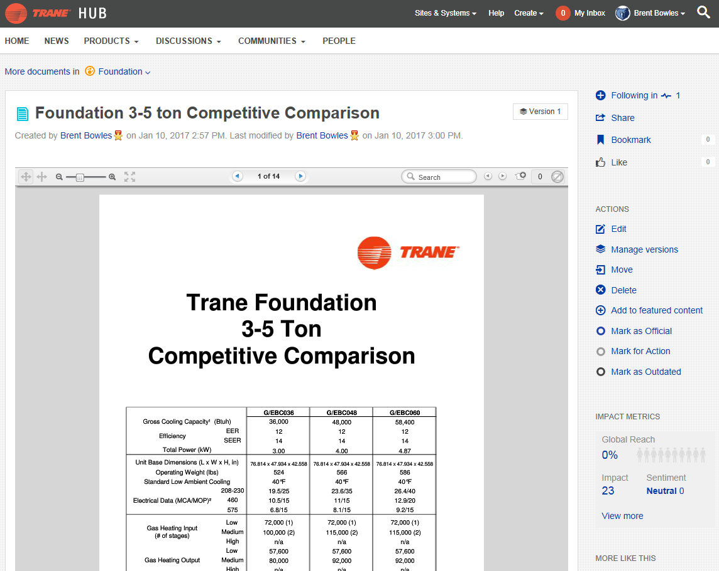
Competitive Comparison
https://hub.ingersollrand.com/docs/DOC-127142
or Search the HUB for “Foundation Competitive Guide”
Notes:
There are some other units in the market like these, like York which we did not talk about today, but if you would like to know more you can go to the HUB and search for “Foundation Competitive Guide” to see a more detailed comparison. This is also available in the Foundation Space that I told you about earlier.

Slide 21
Agenda
Product Positioning
General Information
Competitive Summary
Resources
Notes:
Now back to the Small Foundation unit specifically, let’s talk about some of the resources you will have available to you to help you sell this unit.

Slide 22
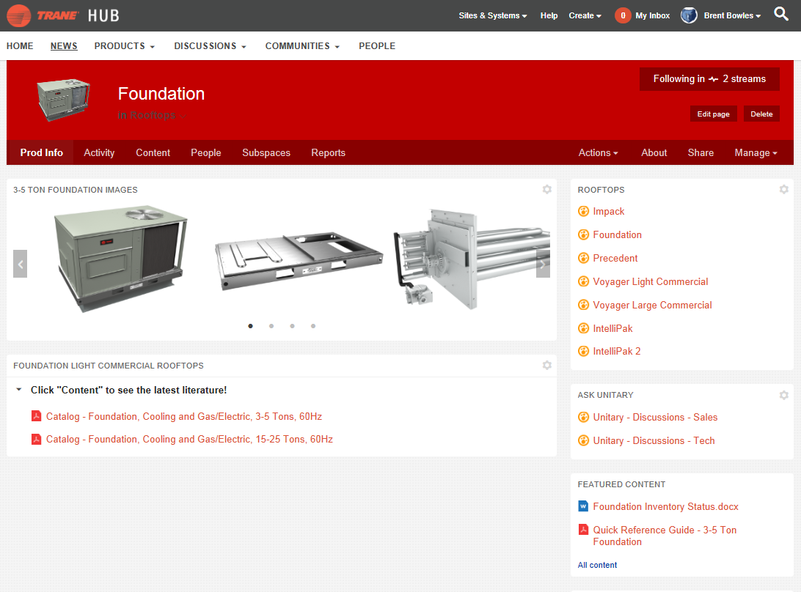
For more information and resources,
visit the Foundation™ space on the HUB:
https://hub.ingersollrand.com/community/products/unitary/unitary-product-library/rooftops/foundation/content
Notes:
Additional resources are available to you on the HUB.

Slide 23
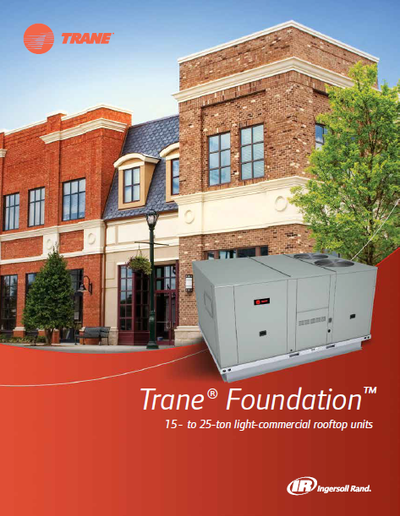
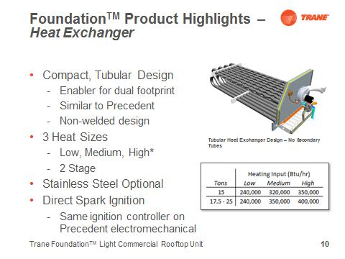
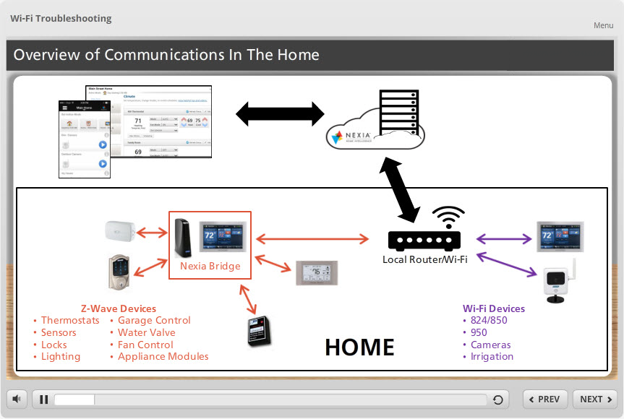
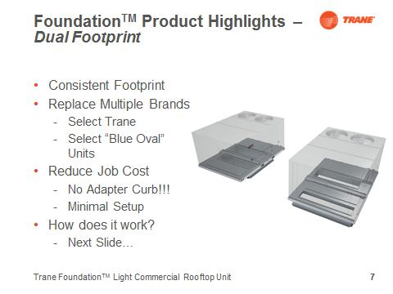
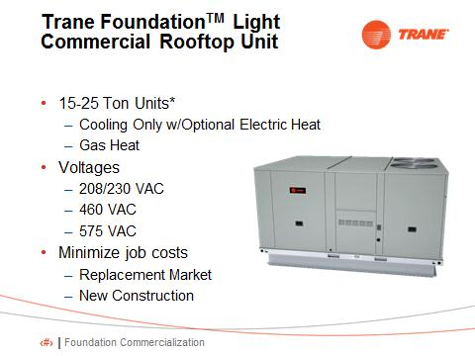
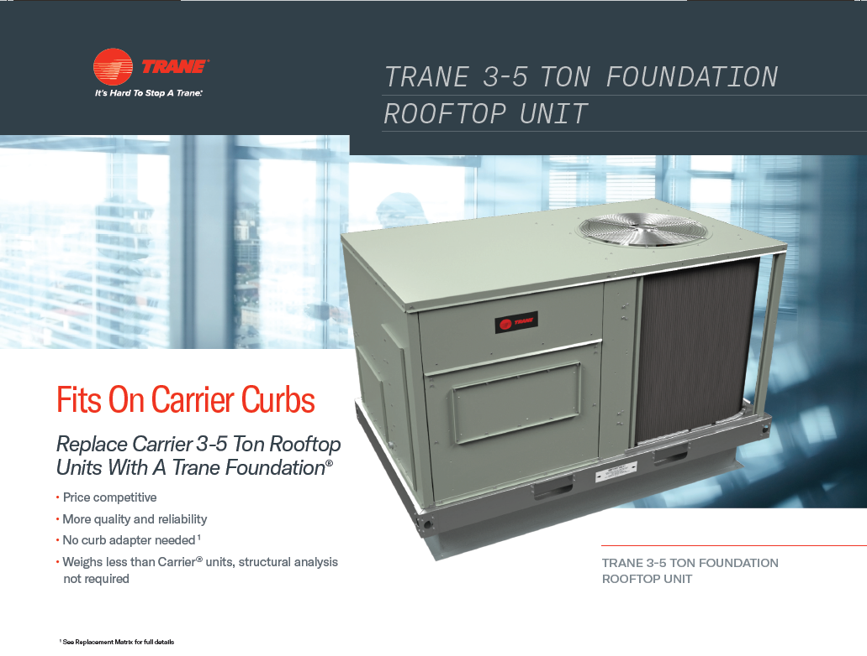
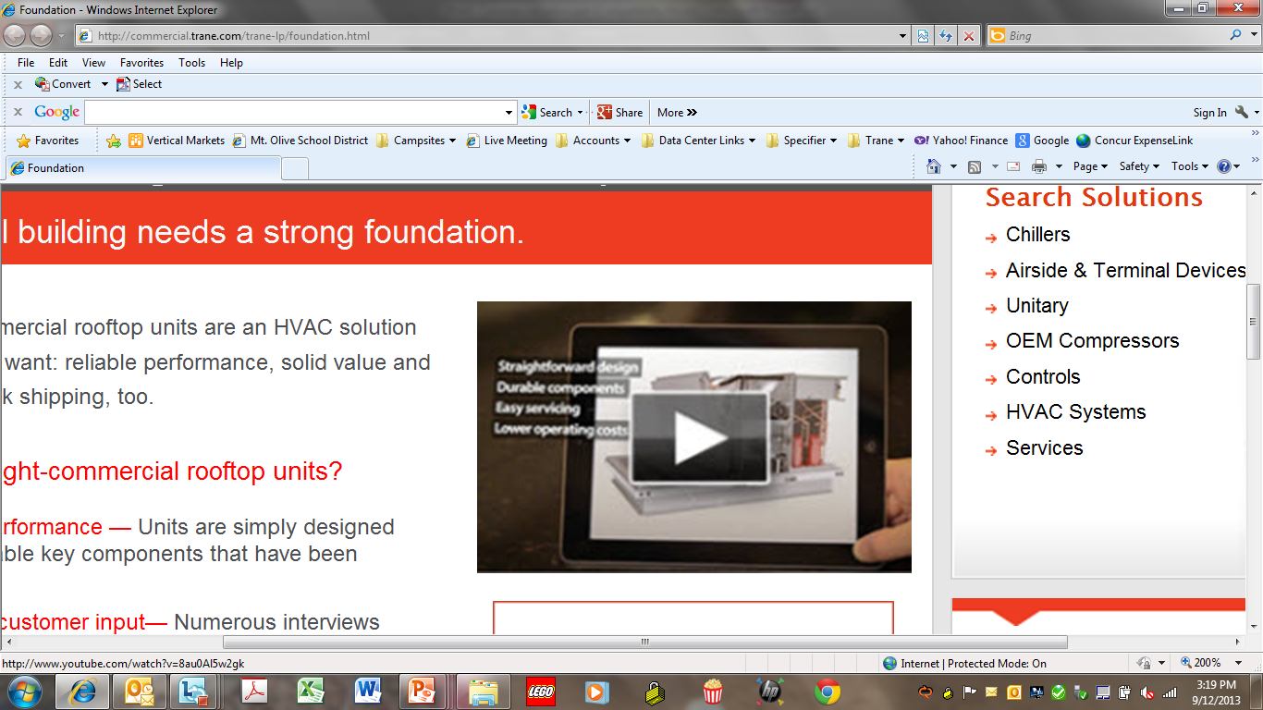
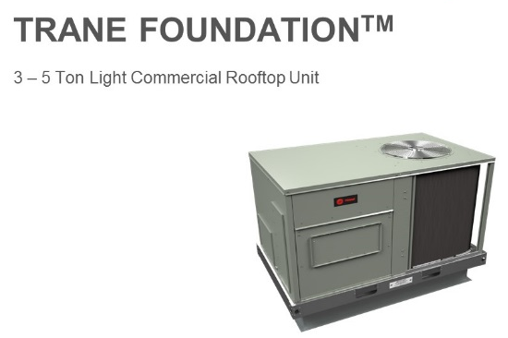

Foundation In The Box Toolkit
Comprehensive Marketing Tools
Product Brochure
Scripted Sales Presentation
ELearning
Flyer
Product Video
Podcast
Webinar
Notes:
We have a product brochure, video and targeting advertising materials available. You can also find information on the trane.com website. There is a scripted sales presentation you can download and use. We have graphics available you can use for an event as well as posters for you to put in your offices.
In addition to this webinar we have some new resources you can access.
Have you listened to any of the podcasts that are advertised in the Connection? Well you will be happy to know that there is now a podcast about the Small Foundation unit. Check out your latest Connection to find the link for the download. In addition there is a course on the LMS you can access to learn more about the product or review what you may have forgotten. Just enter Small Foundation in the search field and it will display.
Want more??? What about a one page brochure you can easily use as a visual aid when talking to your dealers. Check out your latest Connection for links to those resources.

Slide 24
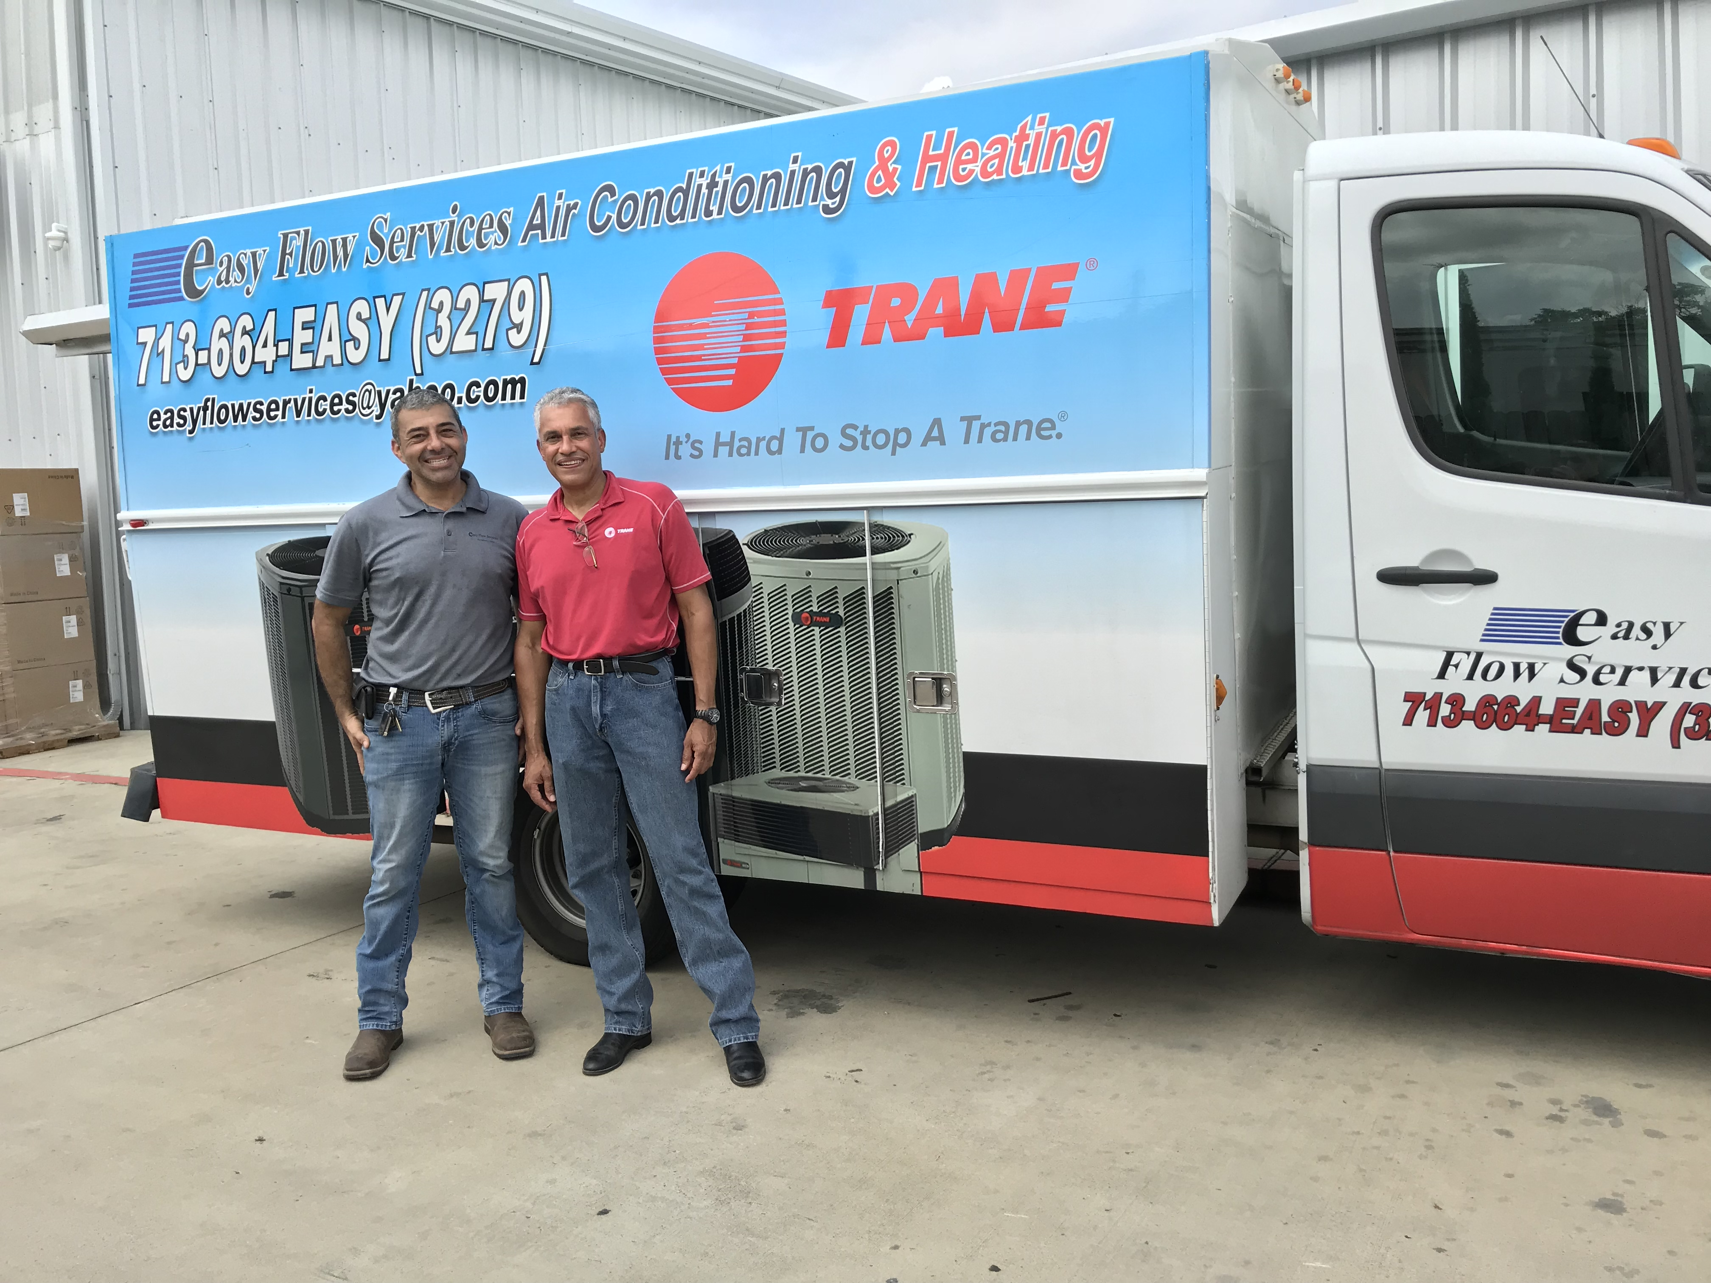
Dealer Testimony and Install
Yair Kol (left) of Easy Flow Services Air Conditioning and Heating with Hunton Distribution Factory Service Representative Angelo Cilie in Houston Texas
Notes:
We visited a job site where Trane Dealer, Yair Kol (left) of Easy Flow Services Air Conditioning and Heating installed 8 Trane 3 - 5 ton Foundation™ units. Yair is pictured here with Hunton Distribution Factory Service Representative Angelo Cilie in Houston Texas.

Slide 25
FSR Testimony
https://fast.wistia.net/embed/iframe/n8y9lkftgt
Notes:
Let’s listen in as Greg Walters, Product Performance Specialist for Trane, interiews Yair about a replacement install he did using the Trane 3 – 5 ton Foundation™ units.

Slide 26
Elevator Speech
What do you want to remember to tell a dealer about the small Foundation™ product?
  No curb adaptor required – fits Carrier® footprint
  Lower cost – since no curb required the cost of the materials and labor is less
  Availability
  Targeted for replacement market with small contractor/dealer in mind
Fits on existing Carrier® Curbs
Price Competitive
Straightforward to install
    No Curb Adaptor Needed
Notes:
Put simply the Foundation™ unit does not require a curb adaptor when replacing a Carrier® unit which means the materials and labor costs are reduced. It is designed for the replacement market and provides a straightforward installation.
We designed the Trane® Foundation™ rooftop unit from the ground up to be a welcome addition to your portfolio.
When we conceived the Trane® Foundation™ light commercial rooftop unit, we started in the right place: from the beginning, with a fresh look at what a light commercial rooftop unit can and should be.
Nothing was overlooked. Nothing was taken for granted.

Slide 27

In Closing…
BIG growth opportunity in LCU rooftops
  Leverage footprint…aggressively target Carrier® replacement opportunities
Great addition to the light commercial rooftop portfolio

Slide 28


FAQs
Our cabinet may be heavier, but our light coils make our units overall lighter than Carrier®
Is it heavy?
3-5T Foundation
Do you need a structural analysis?
No, a structural analysis is not needed for the 3-5T Foundation™
Generally no, in almost all cases, you don’t need the adaptor. It is the same footprint as the Carrier® WeatherMaker®.
Note:
Some curb manufacturers have not updated their websites……they still signal a Curb is required to replace Carrier® with Foundation™
Do you still need a curb adaptor sometimes?
Does the unit hang over the footprint?
it is generally not the case for the 3-5T Foundation™
Notes:
We have assembled a few frequently asked questions that you will find helpful when talking to your dealers.
Is it heavy? The 3 – 5 tone Foundation cabinet is heavier than our competitors, but our light coils make our units overall lighter than theirs.
Do you need a structural analysis? No, a structural analysis is not needed for the 3-5T Foundation (it is needed for the 15-25T, but not the 3-5T)
Do you still need a curb adaptor sometimes? Generally no, in almost all cases, you don’t need the adaptor. It is the same footprint as the Carrier WeatherMaker.
Note:
Some curb manufacturers have not updated their websites……they still signal a Curb is required to replace Carrier with Foundation.
While a Curb Adaptor is needed for 15-25T Large Foundation, it is not needed for the 3-5T
Does the unit hang over the footprint? While this is sometimes something we hear on the 15-25T Foundation (which can be solved with an accessory kit), it is generally not the case for the 3-5T Foundation.

Slide 29
Questions?
Trane, the Circle Logo, Foundation, Impack, Precedent, Voyager, and TOPSS are trademarks of Trane in the United States and other countries. Carrier and WeatherMaker are registered trademarks of the Carrier Corporation. Lennox, Landmark, and Raider are registered trademarks of Lennox Industries Inc. Daiken is a registered trademark of Daiken Industries Ltd. Bryant is a registered trademark of United Technologies Corp. All trademarks referenced are the trademarks of their respective owners.
Trane is a brand of Ingersoll Rand, a world leader in creating comfortable, sustainable and efficient environments. Ingersoll Rand’s family of brands includes Club Car®, Ingersoll Rand®, Thermo King® and Trane®.
© 2018 Trane. All Rights Reserved.
Notes:
Questions and Wrap-up

